Slide 1
Prototype Lab Flow
Presented by Kenneth Mendoza

Slide 2
Introduction
Student can request items from parts crib and prototype lab.
QR codes are used to scan items.
Requested items will be saved in database
Save time and efficiency,

Slide 3
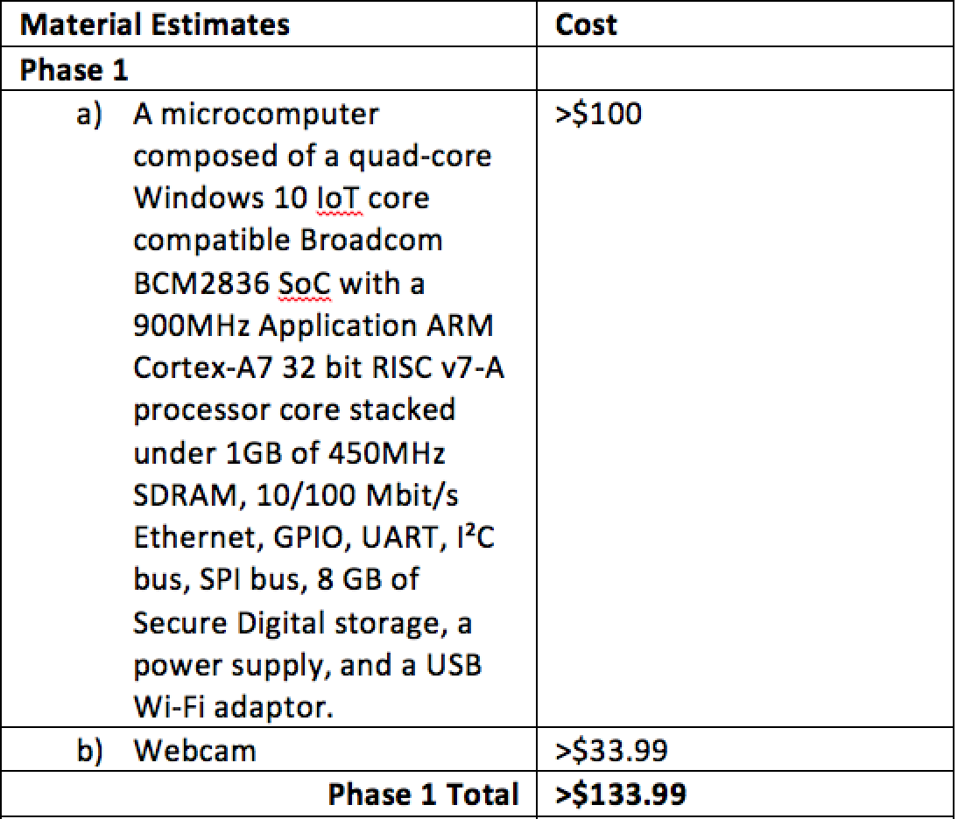
Updated Budget

Slide 4
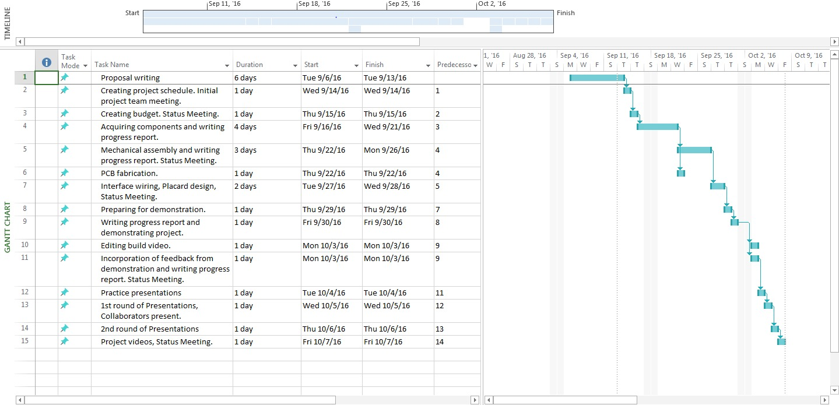
Schedule

Slide 5
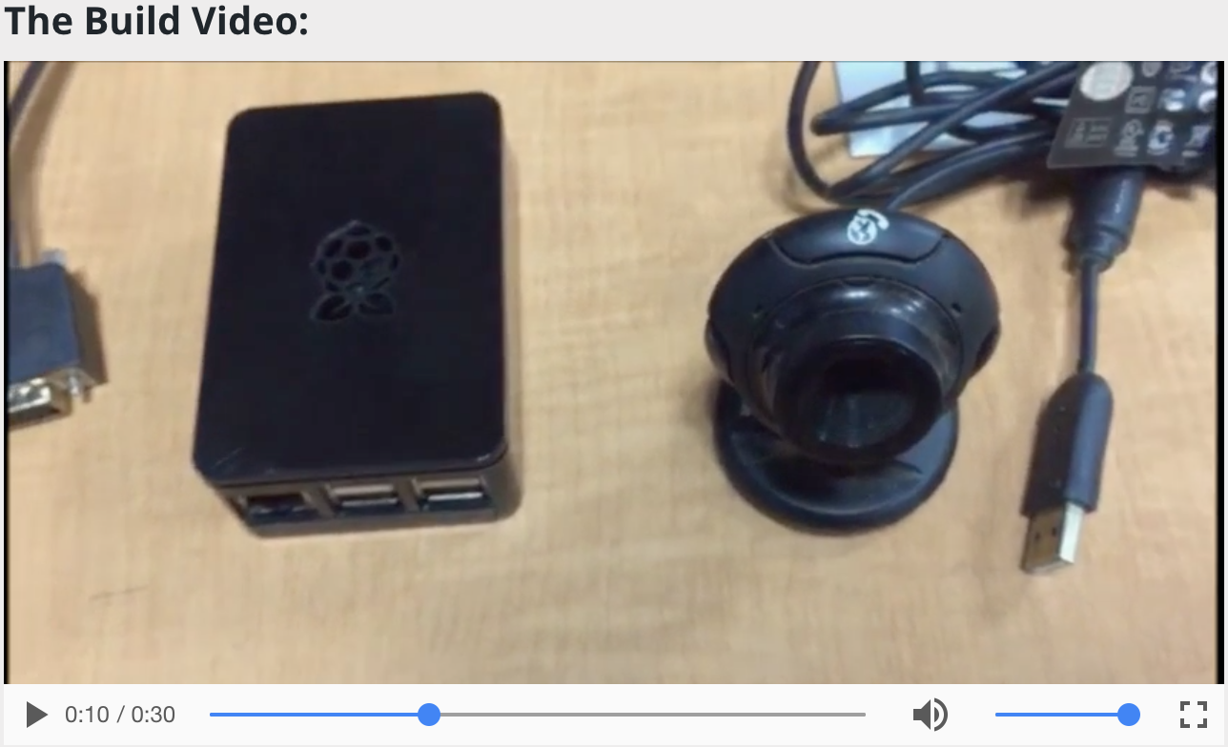
Build Video
30 seconds video of the build of our project.
I’ve used Windows Movie Maker to edit.
I’ve uploaded the video to my github repository

Slide 6
Course Knowledge
Electrical Circuits
Unix Internals
Introduction to Software Engineering
Digital Fundamentals
Embedded Systems

